Slide 1
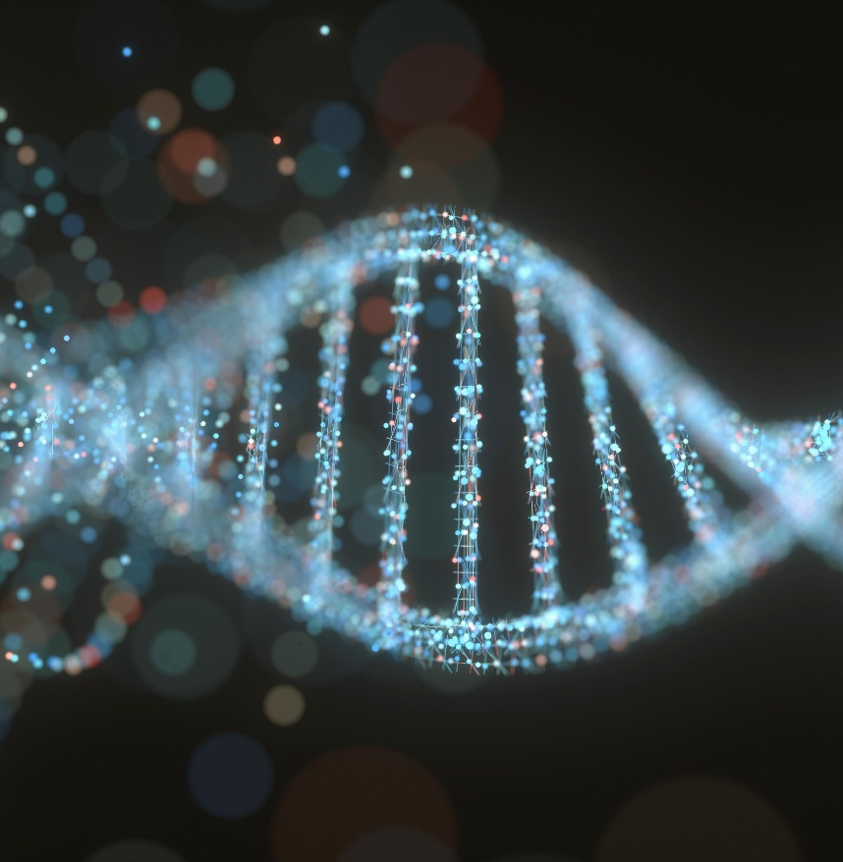

SCI225 · PATHOPHYSIOLOGY
Week Thirteen
The Digestive System
Dr. Vidya Aggrawal Nightingale College
// week 13 visual
Notes:
Welcome to Week 13 — the Digestive System. From motility and digestion to the disorders that disrupt them, all the way through the hepatobiliary system and pediatric GI.

Slide 2

TODAY'S SESSION
Agenda
01
Structure & function — motility, secretion, absorption
02
GI disorders — GERD, IBD, obstruction
03
Hepatobiliary & pediatric GI
04
Knowledge checks & discussion
SCI225 · WEEK 13
02 / 28
Notes:
Today's agenda — three sections.

Slide 3
WEEK THIRTEEN
Learning objectives
1
Recall the structure and function of the digestive system — motility, secretion, and absorption.
2
Describe the alterations of GI function and their consequences.
3
Discuss hepatobiliary and pediatric GI disorders and their clinical presentations.
SCI225 · WEEK 13
03 / 28
Notes:
Three weekly learning objectives.

Slide 4
Weekly resources
Required reading
Clinical tools
GI structure & function chapter
Alterations of digestive function chapter
Week 13 Study Guide — covers all objectives
GI bleeding — melena vs. hematochezia
Bowel obstruction red flags
Digestive cheat sheet — highest-yield patterns
Supplemental
Crohn vs. UC comparison
Jaundice pathways refresher
SCI225 · WEEK 13
04 / 28
Notes:
Required reading and resources.

Slide 5

MODULE THIRTEEN
13
Week Thirteen
The digestive system — motility, secretion, and absorption, then the disorders from GERD and IBD to jaundice, pancreatitis, and the pediatric GI emergencies.
SCI225 · WEEK 13
05 / 28
Notes:
Open Module 13 — Week Thirteen.

Slide 6
ACTION ITEMS
What is due this week?
Week 13 Pre-Assessment — complete before the webinar.
Discussion — apply digestive pathophysiology to a clinical scenario; initial post + 2 peer replies.
Webinar Quiz — covers motility, GERD/ulcers, IBD, obstruction, and hepatobiliary disease.
Case Study — apply GI mechanisms to a patient presentation.
Webinar — GERD, IBD, bowel obstruction, jaundice, and pancreatitis. Bring your reading notes.
SCI225 · WEEK 13
06 / 28
Notes:
What is due this week.

Slide 7
SECTION · STRUCTURE & FUNCTION
Section objective
1
Recall how food moves, gets broken down, and is absorbed — peristalsis, the digestive secretions, and the absorptive surface of the villi.
SCI225 · WEEK 13
07 / 28
Notes:
Section 1 objective — structure and function.

Slide 8
Motility & the GI tract
A muscular tube run by the autonomic nervous system
Process
Mechanism
Swallowing / esophageal transit
Peristalsis (smooth-muscle waves) pushes the bolus down
Gastric emptying
A high-fat meal slows emptying (fat triggers CCK, which delays the stomach)
Defecation reflex
Rectal stretch triggers the urge; impaired reflex → retention / constipation
Autonomic control
Parasympathetic stimulates GI activity; anticholinergics block it → dry mouth, slowed motility
Key idea: parasympathetic = "rest and digest." Acetylcholine drives salivation and peristalsis — anticholinergics block it → dry mouth, slowed gut, constipation.
SCI225 · WEEK 13
08 / 28
Notes:
Motility and the GI tract — peristalsis and autonomic control.

Slide 9
Secretion & digestion
Secretion (source)
Job
Gastric acid + intrinsic factor (parietal cells)
Acid digests/sterilizes; intrinsic factor is needed to absorb vitamin B12
Pancreatic enzymes
Digest carbs, protein, and fat in the duodenum
Pancreatic bicarbonate
Neutralizes stomach acid entering the duodenum
Bile (liver; stored in gallbladder)
Emulsifies fat — breaks globules into droplets so enzymes can digest them
Key idea: parietal cells make acid and intrinsic factor — damage them and you get low acid plus B12 malabsorption (pernicious anemia).
SCI225 · WEEK 13
09 / 28
Notes:
Secretion and digestion — acid, enzymes, bicarbonate, bile.

Slide 10
Absorption & malabsorption
Disorder
Mechanism
Result
Celiac disease
Immune reaction to gluten flattens/shortens the villi
↓ absorptive surface → chronic diarrhea, weight loss, deficiencies
Cystic fibrosis
Thick secretions block pancreatic ducts → enzymes can't reach the gut
Fat malabsorption → steatorrhea, poor growth
Pancreatic insufficiency
Too few pancreatic enzymes (incl. lipase)
Steatorrhea (fatty, floating, foul stools)
Key idea: absorption needs working villi (surface) and digestive juices (enzymes + bile). Celiac destroys the surface; CF / pancreatic insufficiency starve the gut of enzymes → fat malabsorption.
SCI225 · WEEK 13
10 / 28
Notes:
Absorption and malabsorption — celiac, CF, pancreatic insufficiency.

Slide 11
KNOWLEDGE CHECK
Question 1
A patient on an anticholinergic medication reports dry mouth. Which mechanism explains it?
A
Blocked parasympathetic (acetylcholine) signaling reduces salivation
B
Increased parasympathetic activity
C
Excess salivary secretion
D
Increased peristalsis
SCI225 · WEEK 13
11 / 28
Notes:
Knowledge check — anticholinergic dry mouth.

Slide 12
KNOWLEDGE CHECK
Question 2
A patient has damage to gastric parietal cells. Which change is expected?
A
Decreased acid and impaired vitamin B12 absorption (loss of intrinsic factor)
B
Increased acid secretion
C
Increased intrinsic factor
D
Improved B12 absorption
SCI225 · WEEK 13
12 / 28
Notes:
Knowledge check — parietal cells and B12.

Slide 13
KNOWLEDGE CHECK
Question 3
A patient with celiac disease has chronic diarrhea and weight loss. Which outcome from shortened intestinal villi explains it?
A
Reduced absorptive surface area causing malabsorption
B
Increased surface area for absorption
C
Increased enzyme secretion
D
Faster nutrient uptake
SCI225 · WEEK 13
13 / 28
Notes:
Knowledge check — celiac villi.

Slide 14
SECTION · GI DISORDERS
Section objective
2
Describe the alterations of GI function — upper-GI acid and bleeding disorders, the inflammatory bowel diseases, and mechanical obstruction.
SCI225 · WEEK 13
14 / 28
Notes:
Section 2 objective — GI disorders.

Slide 15
Upper GI — GERD, ulcers & bleeding
Disorder
Mechanism
GERD
Weak/relaxed lower esophageal sphincter lets acid reflux up. Risk: obesity, hiatal hernia, fatty/large meals, lying down after eating
Peptic ulcer disease
Mucosal defense fails against acid — mainly H. pylori and NSAIDs (also smoking, alcohol, stress)
Esophageal varices
Portal hypertension swells esophageal veins → can rupture → massive bright-red hematemesis
Reading GI bleeds: melena (black, tarry stool) = upper GI bleed (blood digested in transit); hematochezia (bright-red rectal blood) = lower GI source.
SCI225 · WEEK 13
15 / 28
Notes:
Upper GI — GERD, ulcers, and reading GI bleeding.

Slide 16
Inflammatory bowel disease — Crohn vs. UC
Crohn disease
Ulcerative colitis
Location: anywhere mouth → anus; skip lesions
Location: colon/rectum only; continuous
Depth: transmural (full wall) → fistulas, strictures
Depth: mucosa/submucosa only
Stool: diarrhea, less bloody
Stool: bloody diarrhea with urgency
Increased cancer risk
Higher colorectal cancer risk → surveillance colonoscopy
Best distinguisher: Crohn can affect any part of the GI tract with skip lesions; UC is continuous and colon-only. Watch for appendicitis/diverticulitis → peritonitis.
SCI225 · WEEK 13
16 / 28
Notes:
Inflammatory GI disease and IBD — Crohn versus UC.

Slide 17
MECHANICAL
Bowel obstruction
Classic picture: distension, cramping pain, vomiting, and no flatus/stool (obstipation).
Causes: adhesions, hernia, tumor block the lumen; bowel sounds first high-pitched/hyperactive, then absent.
Intussusception (child): one segment telescopes into another → obstruction + compromised blood flow → currant-jelly stools.
Hirschsprung disease (newborn): absent ganglion cells → no peristalsis in that segment → functional obstruction → constipation from birth.
Feared complication: bowel ischemia / perforation → peritonitis.
SCI225 · WEEK 13
17 / 28
Notes:
Bowel obstruction.

Slide 18
KNOWLEDGE CHECK
Question 4
Which change allows gastric contents to reflux into the esophagus in GERD?
A
A weakened/relaxed lower esophageal sphincter
B
A tightened LES
C
Increased esophageal peristalsis
D
Decreased gastric acid
SCI225 · WEEK 13
18 / 28
Notes:
Knowledge check — GERD.

Slide 19
KNOWLEDGE CHECK
Question 5
Which statement distinguishes Crohn disease from ulcerative colitis?
A
Crohn can affect any part of the GI tract with skip lesions; UC is continuous and colon-only
B
UC affects the entire GI tract; Crohn affects only the rectum
C
Both are limited to the colon
D
Crohn is mucosal only
SCI225 · WEEK 13
19 / 28
Notes:
Knowledge check — Crohn versus UC.

Slide 20
KNOWLEDGE CHECK
Question 6
A patient has abdominal distension, vomiting, cramping pain, and no flatus. What process is occurring?
A
Bowel obstruction
B
Diarrhea
C
GERD
D
Normal digestion
SCI225 · WEEK 13
20 / 28
Notes:
Knowledge check — bowel obstruction.

Slide 21
SECTION · HEPATOBILIARY & PEDIATRIC GI
Section objective
3
Discuss the liver, gallbladder, and pancreas — jaundice, cirrhosis, pancreatitis — plus the pediatric GI conditions you must recognize.
SCI225 · WEEK 13
21 / 28
Notes:
Section 3 objective — hepatobiliary and pediatric.

Slide 22
Liver — jaundice & cirrhosis
Jaundice type
Mechanism
Pre-hepatic (hemolytic)
Too much RBC breakdown → excess unconjugated bilirubin overwhelms the liver
Hepatic
Damaged liver cells can't process/conjugate bilirubin
Post-hepatic (cholestatic)
Blocked bile flow → conjugated bilirubin backs up → dark urine, pale stools, pruritus
Cirrhosis → fibrosis replaces functional liver → portal hypertension → esophageal varices, splenomegaly, ascites (worsened by low albumin / low oncotic pressure).
SCI225 · WEEK 13
22 / 28
Notes:
Liver — jaundice and cirrhosis.

Slide 23
Gallbladder & pancreas
Disorder
Mechanism & clues
Cholelithiasis / cholecystitis
Gallstones block bile flow / inflame the gallbladder → RUQ pain after fatty meals, fever, nausea
Pancreatitis
Pancreatic enzymes activate inside the pancreas and autodigest it → severe epigastric pain radiating to the back
Pancreatic insufficiency
Too few enzymes (incl. lipase) → fat malabsorption → steatorrhea
Key idea: pancreatitis is autodigestion — enzymes activate prematurely within the pancreas and digest the organ. Common causes: gallstones and alcohol.
SCI225 · WEEK 13
23 / 28
Notes:
Gallbladder and pancreas.

Slide 24
Pediatric GI
Condition
Mechanism & hallmark
Pyloric stenosis
Thickened pyloric muscle obstructs gastric outlet → forceful, projectile, NON-bilious vomiting (block before the bile duct entry)
Intussusception
Bowel telescopes → obstruction + ischemia → currant-jelly stools, intermittent severe pain
Hirschsprung disease
Absent ganglion cells → no peristalsis → constipation/obstruction from birth
Necrotizing enterocolitis (NEC)
Premature infant; bowel inflammation/ischemia → distension, feeding intolerance, bloody stools — emergency
Non-bilious vs. bilious: pyloric stenosis blocks above the bile duct → non-bilious (projectile) vomiting. Obstructions below it → bilious (green) vomiting.
SCI225 · WEEK 13
24 / 28
Notes:
Pediatric GI — pyloric stenosis, intussusception, Hirschsprung, NEC.

Slide 25
KNOWLEDGE CHECK
Question 7
A patient reports yellowing skin, dark urine, and pale stools. Which mechanism explains it?
A
Blocked bile flow backs up conjugated bilirubin (cholestasis)
B
Increased bile excretion
C
Excess RBC production
D
Increased albumin
SCI225 · WEEK 13
25 / 28
Notes:
Knowledge check — cholestatic jaundice.

Slide 26
KNOWLEDGE CHECK
Question 8
Which mechanism explains the abdominal pain of pancreatitis?
A
Premature enzyme activation autodigesting the pancreas and causing inflammation
B
Gallbladder contraction
C
Decreased pancreatic enzymes
D
Esophageal reflux
SCI225 · WEEK 13
26 / 28
Notes:
Knowledge check — pancreatitis.

Slide 27
KNOWLEDGE CHECK
Question 9
Which change explains forceful, non-bilious vomiting in an infant?
A
Pyloric muscle thickening obstructs the gastric outlet (above the bile duct)
B
A lower bowel obstruction
C
Bile reflux into the stomach
D
Esophageal sphincter relaxation
SCI225 · WEEK 13
27 / 28
Notes:
Knowledge check — pyloric stenosis.

Slide 28
“
Follow the tube and follow the juices. Every digestive disorder is either a motility problem, a secretion problem, an absorption problem, or a blockage — name which, and the patient's symptoms explain themselves.
DR. VIDYA AGGRAWAL · PATHOPHYSIOLOGY COURSE INSTRUCTOR · NIGHTINGALE COLLEGE
SCI225 · WEEK 13
28 / 28
Notes:
Closing — follow the tube, follow the juices.

